Slide 1
Capstone Project Driving a Taxi in Buenos Aires
Coursera – Applied Data Science Capstone Course

Slide 2
Problem Statement
In this Project we will answer the following questions:
What are the most profitable days and shifts (morning, evenings or nights) to drive a taxi?
What is the neighborhood with the best balance of taxi traffic and gastronomy options?
While the target audience of this exercise is my friend Juan, who lost his job during the Covid 19 crisis, the problem statement is relevant for any taxi owner in the city of Buenos Aires

Slide 3
Data Acquisition and Cleansing
Buenos Aires Government open Portal that provides geo referential data of the city of Buenos Aires: data.buenosaires.gob.ar
Foursquare to explore the neighborhoods: foursquare API
Data from the BA Taxi app service, a government sponsored initiative to securely travel in Taxis: BA Taxi
A dataset of +19K taxi trips in Buenos Aires requested through the BA Taxi app: BA Taxi Trips

Slide 4
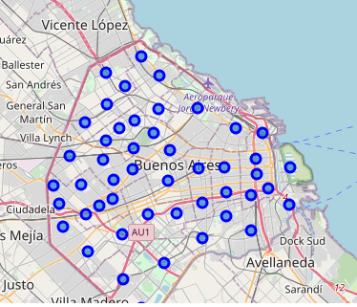
Understanding the Data Sets
City of Buenos Aires with blue markers in its 48 neighborhoods

Slide 5
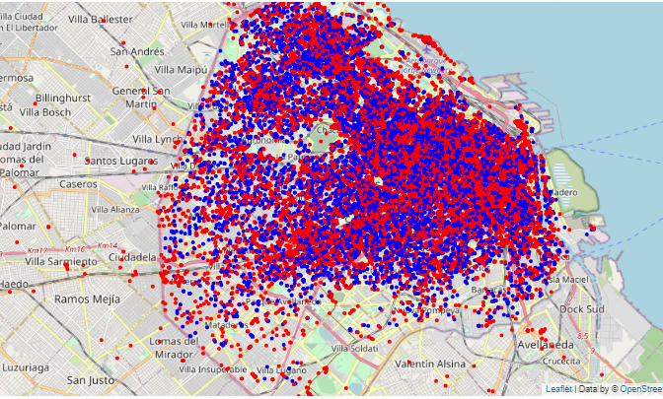
The Taxi Trips Dataset is dense enough
Taxi Trip Origin
Taxi Trip Destination

Slide 6
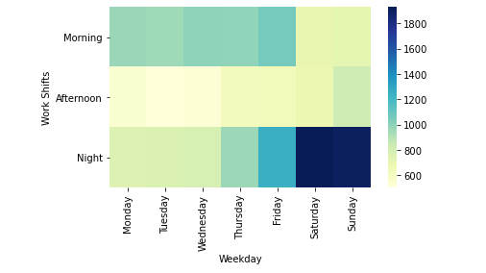
Taxi trips HeatMap
Greatest demand for taxi trips happen during weekends on the night shift followed by the mornings during weekdays

Slide 7
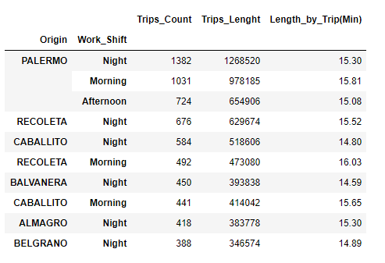
Taxi trips by Neighborhood

Slide 8
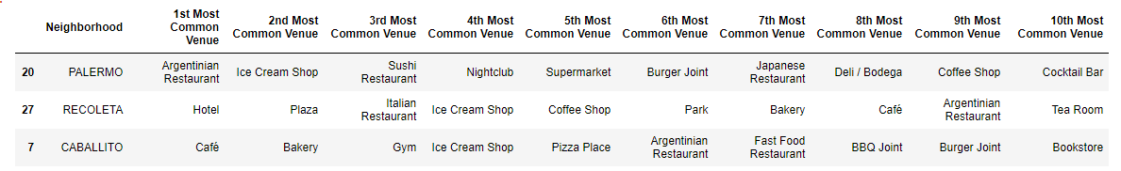
Exploring Neighborhoods
Looking at the most common venues in our target neighborhoods

Slide 9
Conclusions
What are the most profitable days and shifts (morning, evenings or nights) to drive a taxi?
We found that the night shift and the weekends are the busiest slots, hence the most profitable for driving a Taxi
What is the neighborhood with the best balance of taxi traffic and gastronomy options?
We found that the 3 top neighborhoods (Palermo, Recoleta and Caballito) in terms of taxi trips have plenty of gastronomy options and nightclubs, which correlates well with the idea of weekend night taxi traffic.
For all the above, our final recommendation for Juan is to move to Palermo where he will enjoy good gastronomy options and select the night shifts and weekend days to drive the taxi to maximize his income

